Slide 1
Who are we?

Slide 2
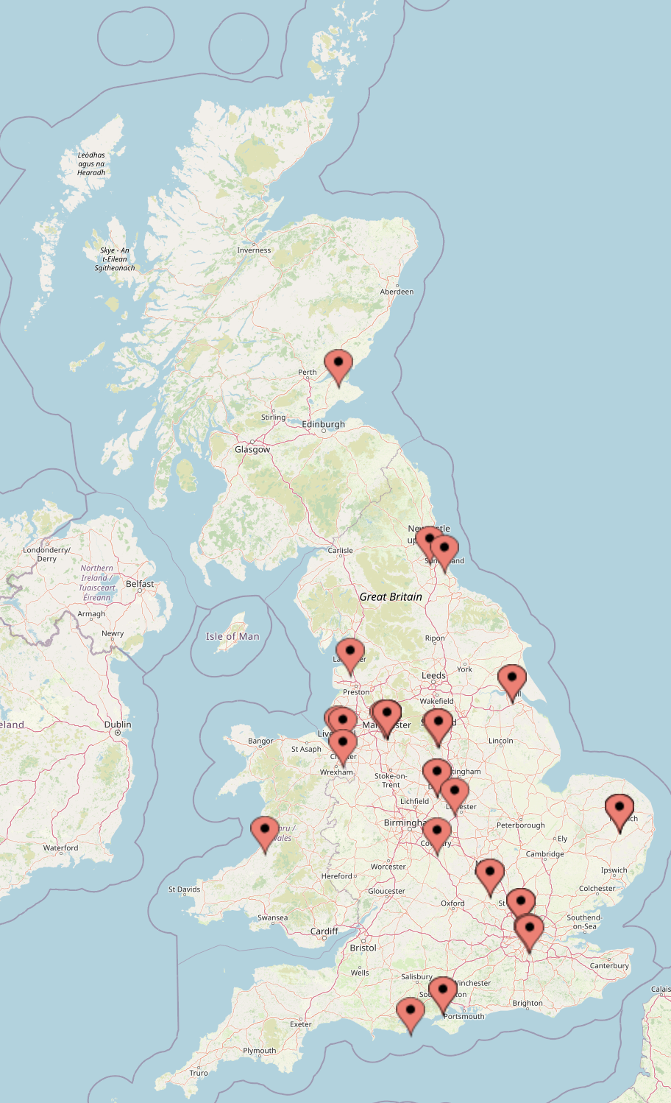
Group Makeup
55 participants registered
32 universities represented

Slide 3
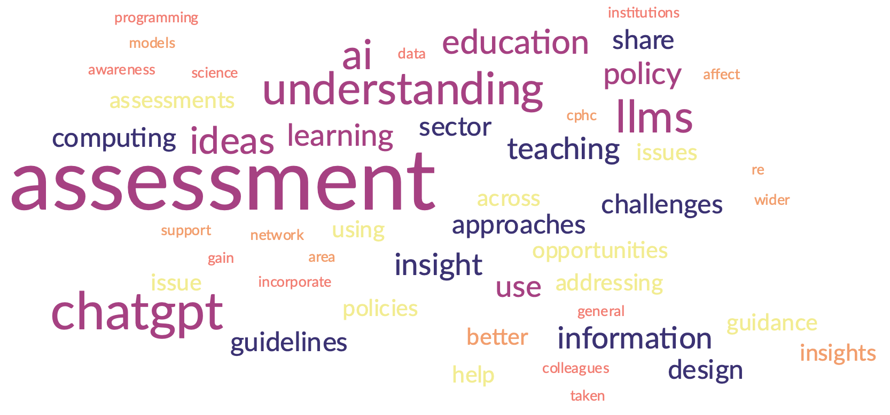
What do you hope to get from the workshop?

Slide 4

How will you disseminate the findings to your department/institution?

Slide 5
GPT in Education
Matthew Shardlow

Slide 6
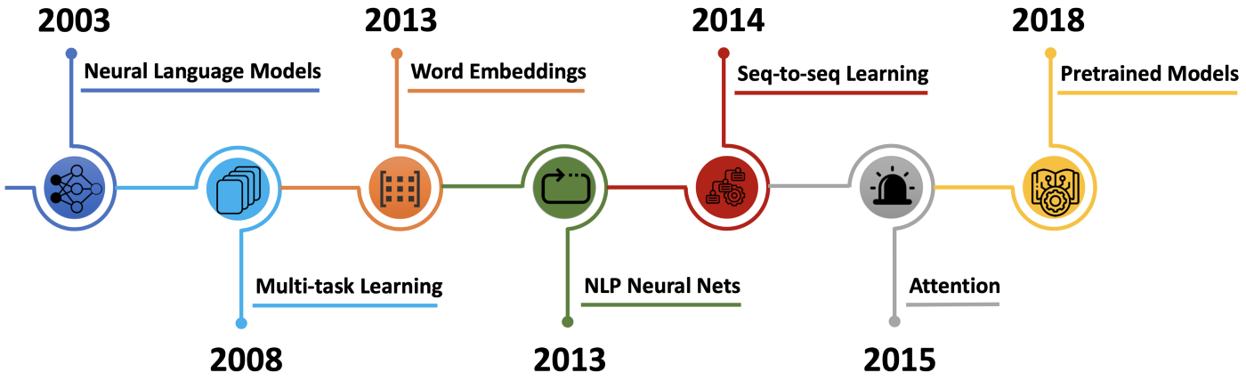

Slide 7
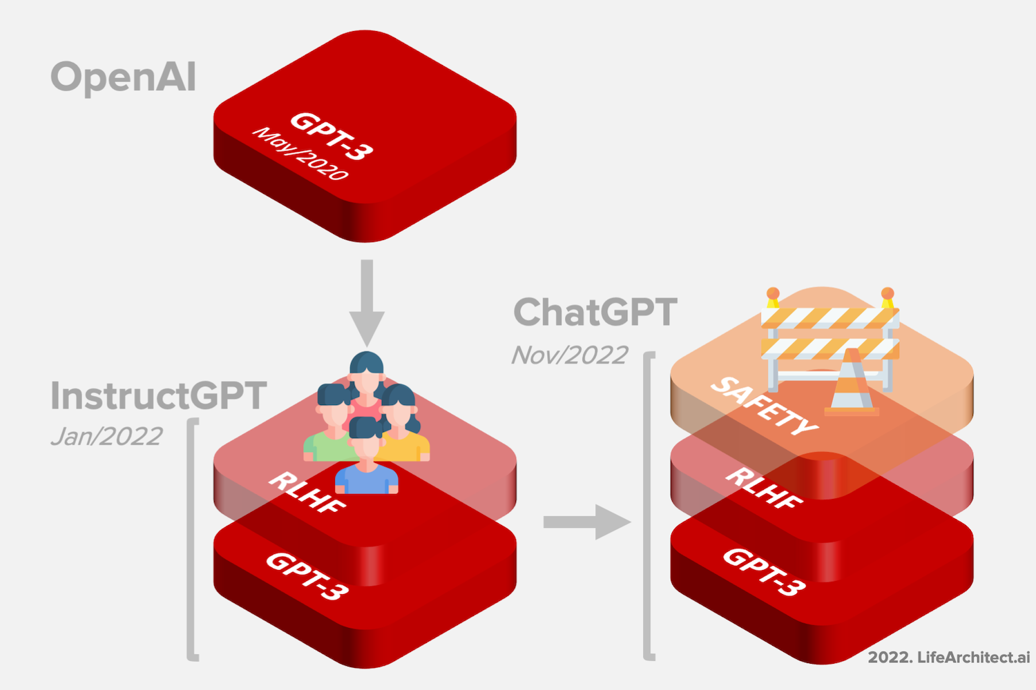
Training – Modelling Language

Slide 8
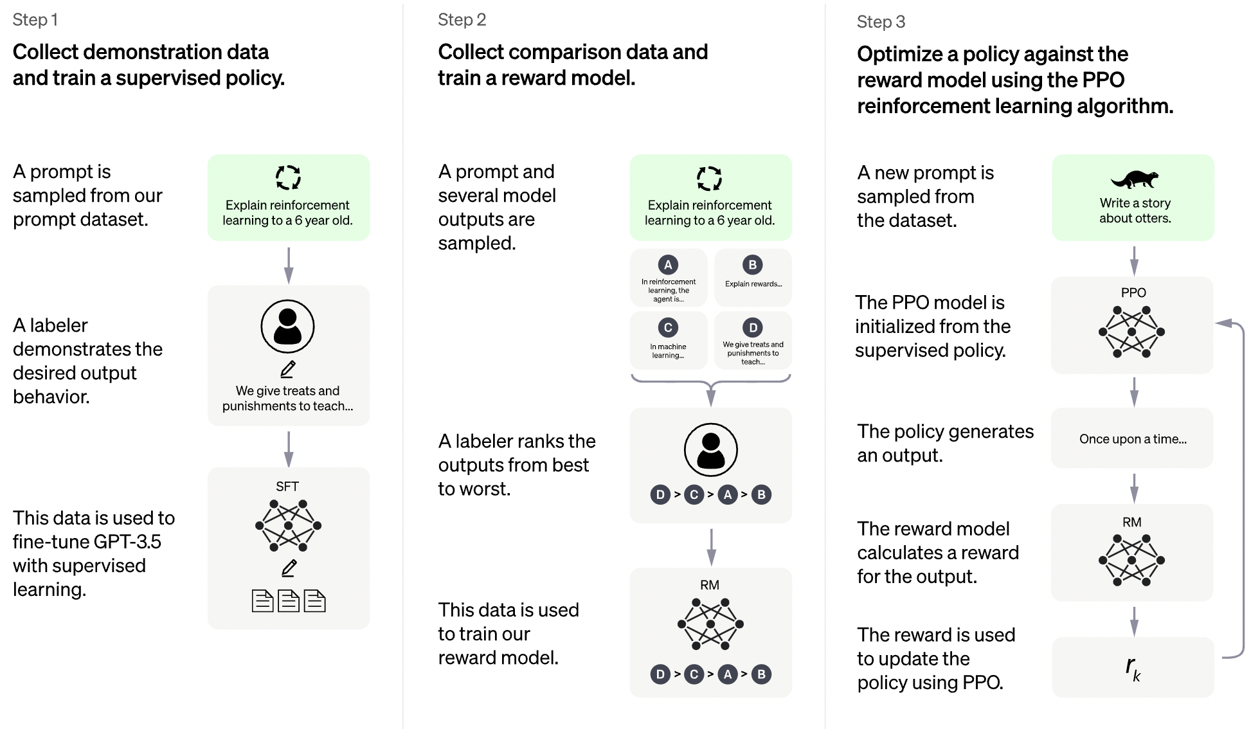
What is ChatGPT

Slide 9

Next Word Prediction

Slide 10
GPT-3
The

Slide 11
 | cat
GPT-3
The

Slide 12
 | cat
GPT-3
The | cat

Slide 13
 | cat | sat
GPT-3
The | cat

Slide 14
 | cat | sat | on
GPT-3
The | cat | sat

Slide 15
 | cat | sat | on | the
GPT-3
The | cat | sat | on

Slide 16
 | cat | sat | on | the | mat
GPT-3
The | cat | sat | on | the

Slide 17
 | cat | sat | on | the | mat | .
GPT-3
The | cat | sat | on | the | mat

Slide 18
 | cat | sat | on | the | mat | . | END
GPT-3
The | cat | sat | on | the | mat | .

Slide 19
What Can ChatGPT Do?

Slide 20
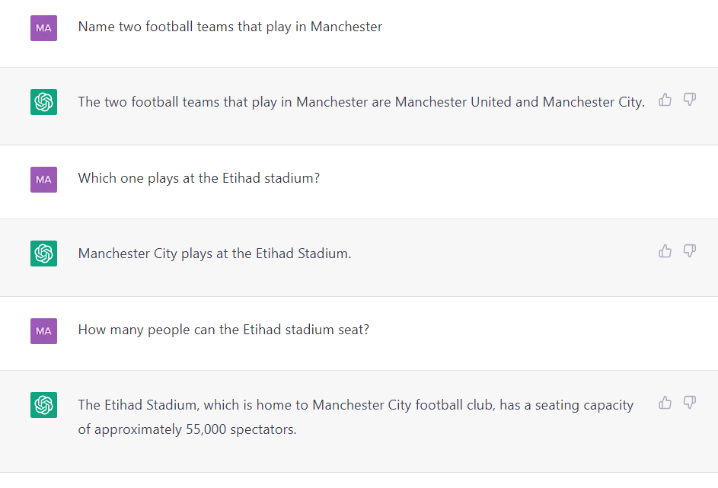

Slide 21
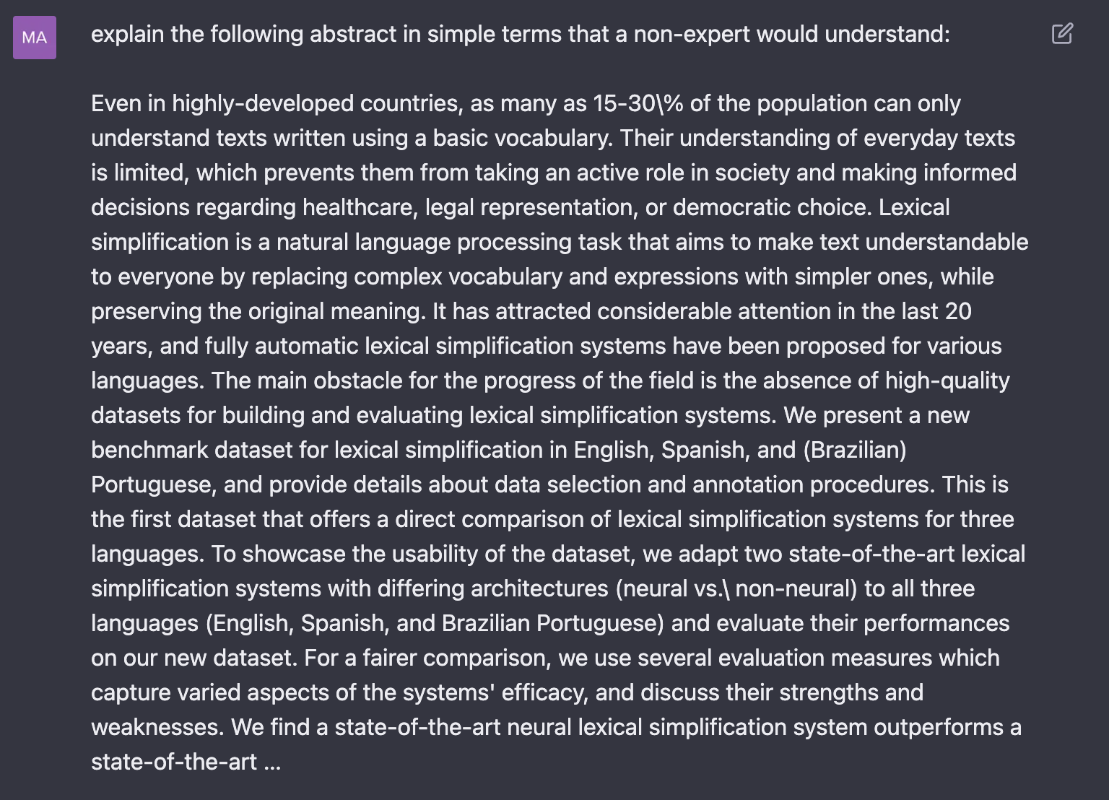

Slide 22
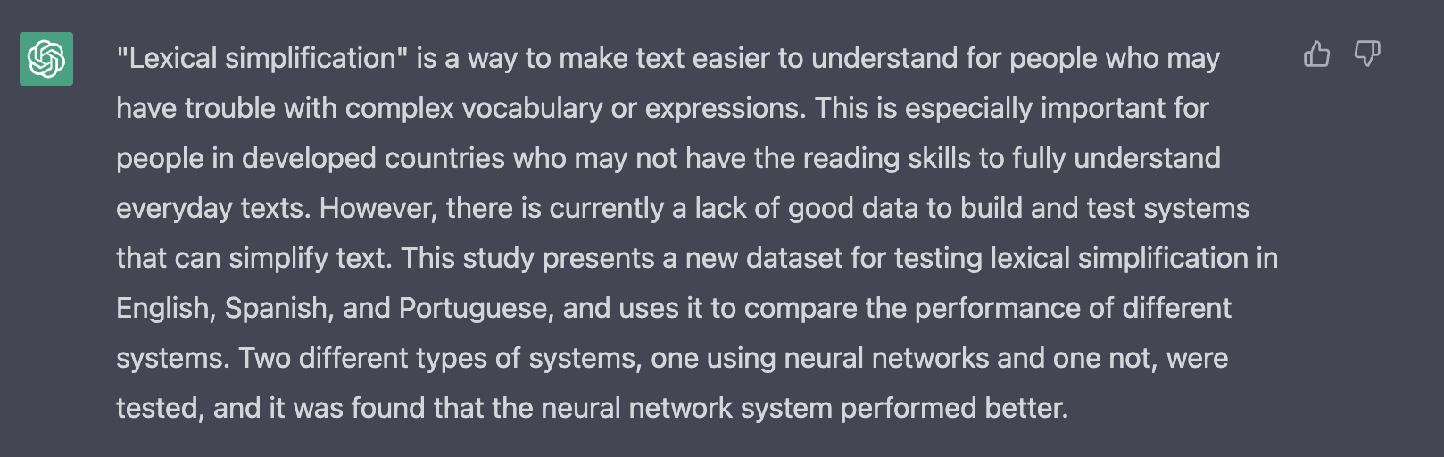

Slide 23
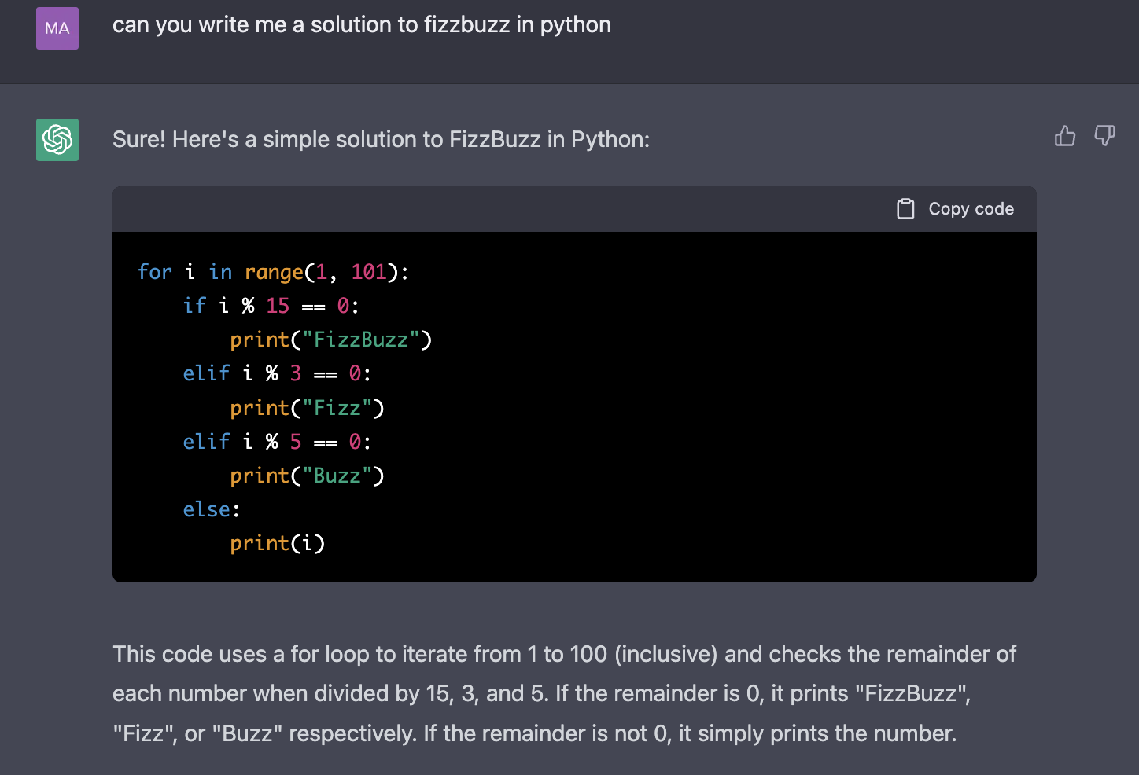

Slide 24
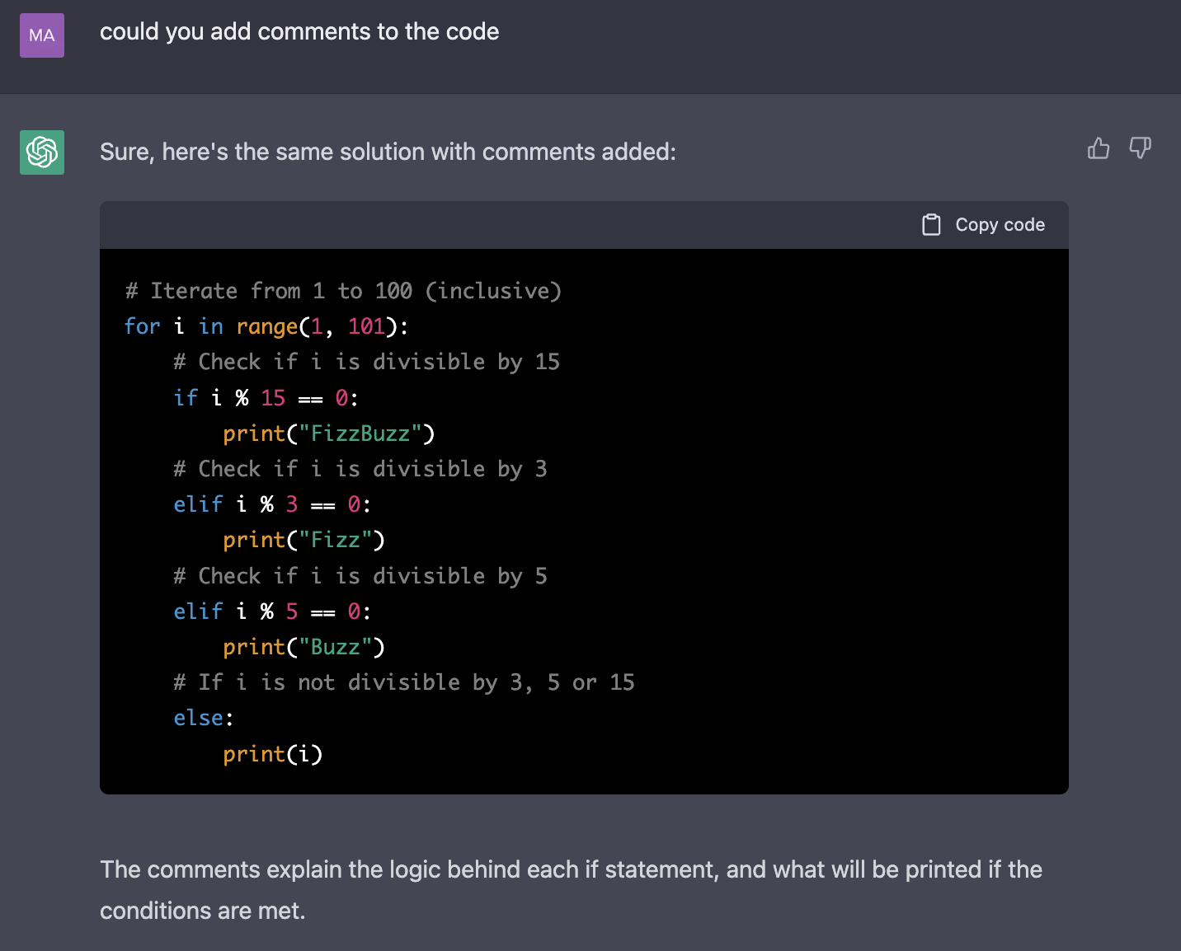

Slide 25
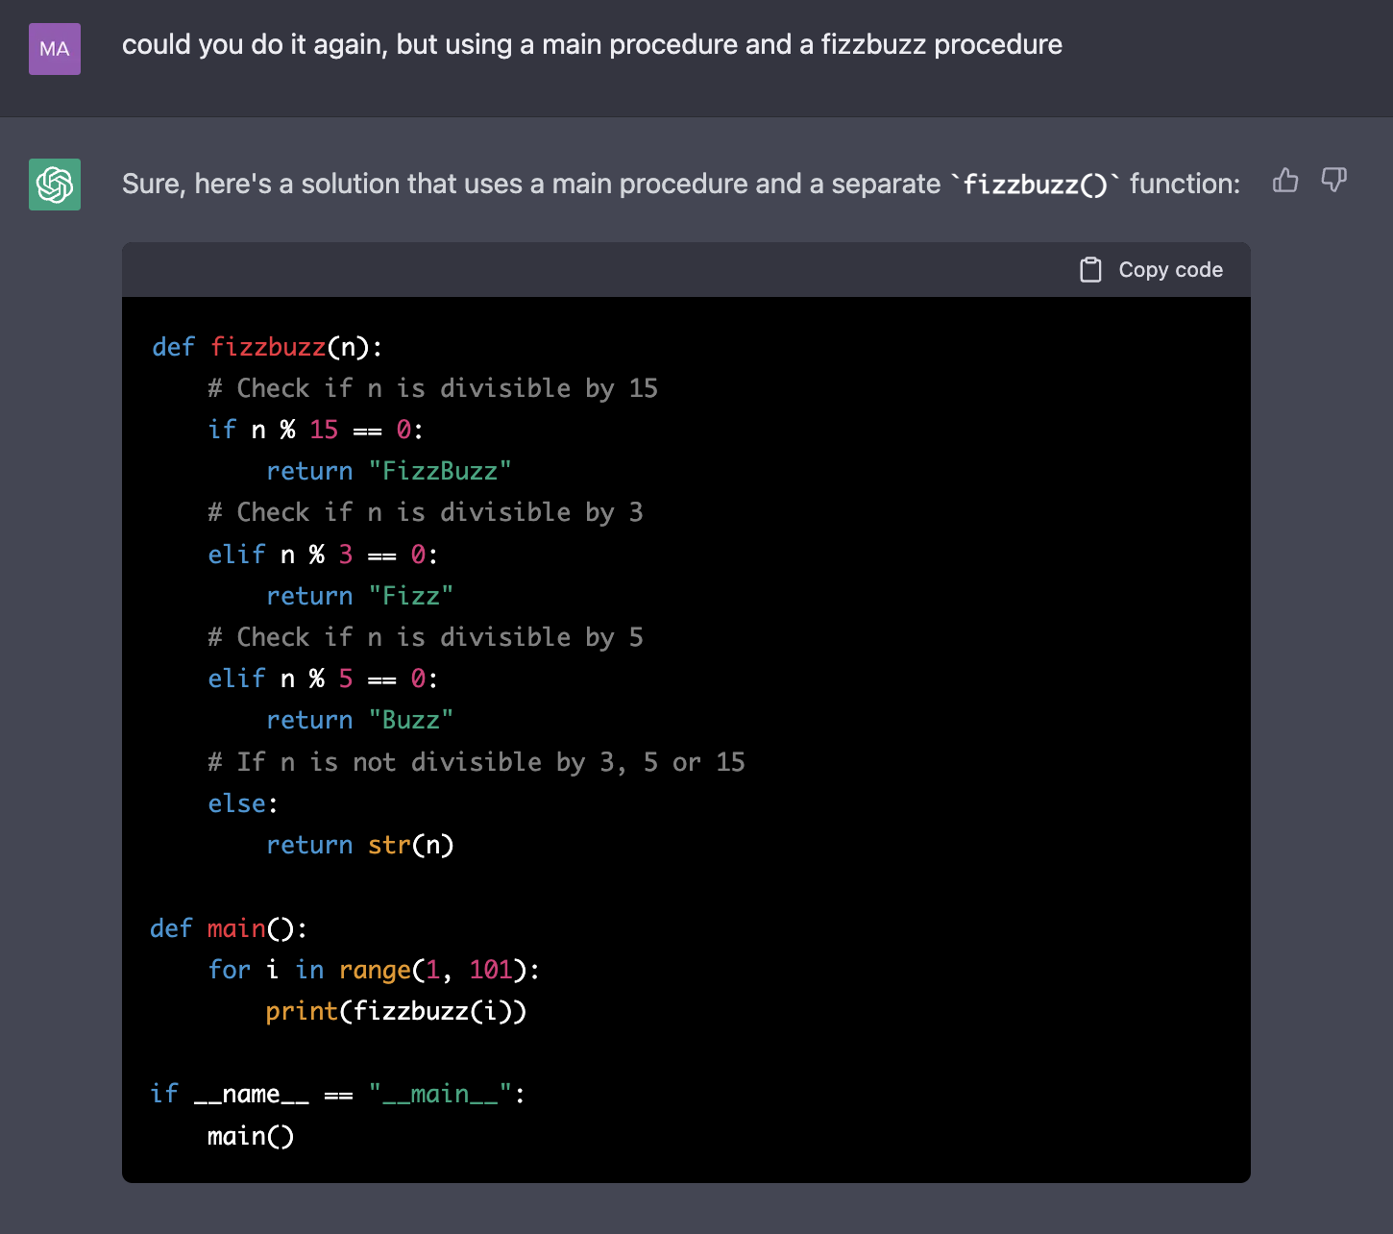

Slide 26
What Can ChatGPT Not Do?

Slide 27
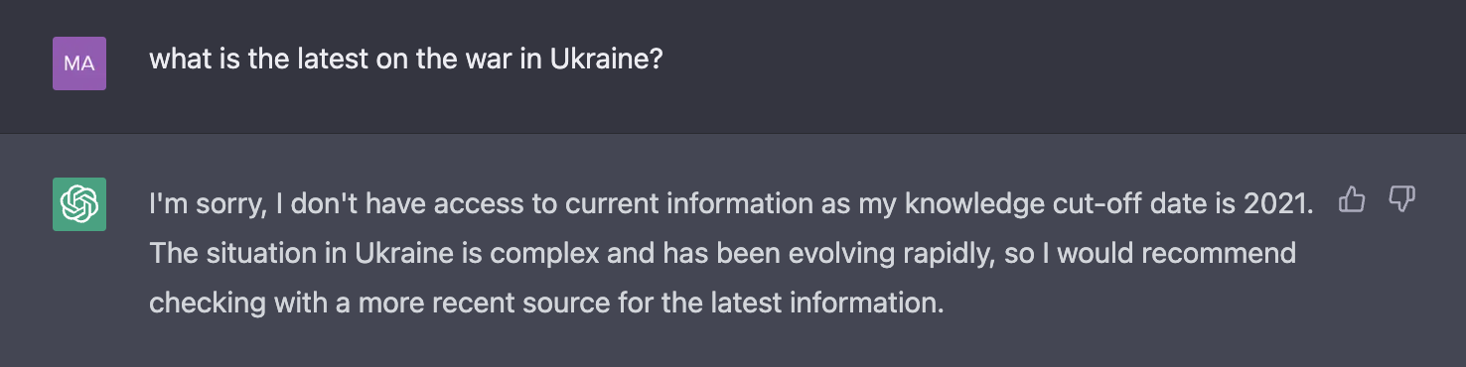

Slide 28
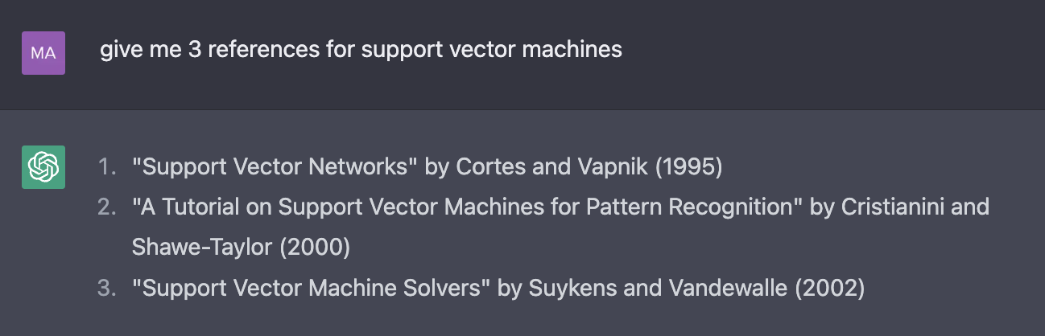

Slide 29
Correct Reference
Not a paper,
wrong authors
Wrong authors

Slide 30
ChatGPT in Education

Slide 31
Educator
Generate problem sets
Give feedback on assessments
Automate grading of assessments
Set more challenging assignments
Teach students to code with AI

Slide 32
Student
Informational resource
Simplification of complex terminology
Explanation of code / complex concepts
Generation of ideas
Assisted coding

Slide 33
Accessing Generative AI

Slide 34
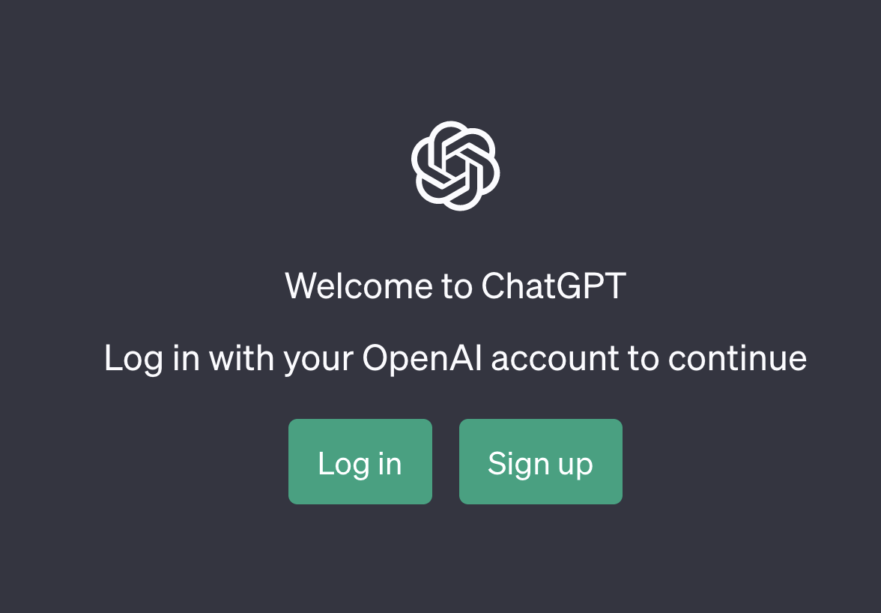
ChatGPT (OpenAI)
Go to chat.openai.com

Slide 35
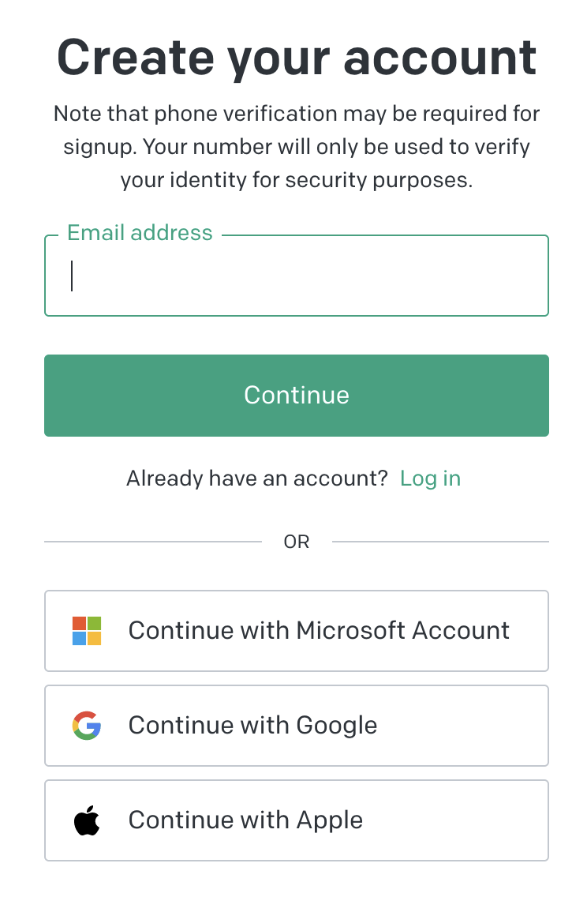
ChatGPT (OpenAI)
Go to chat.openai.com

Slide 36
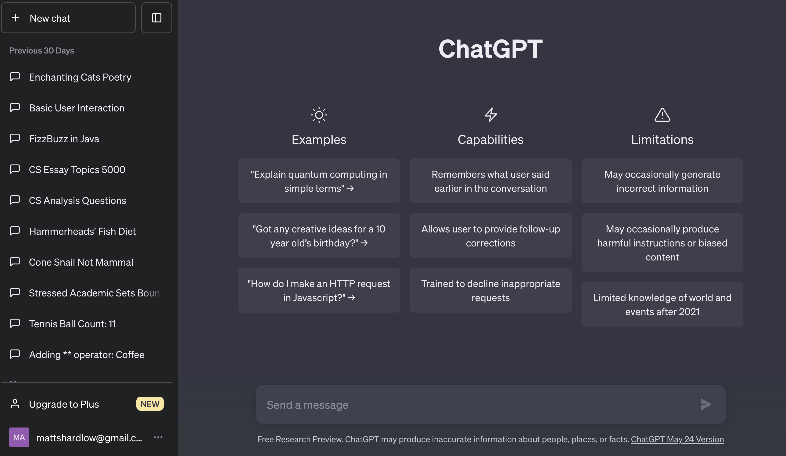
ChatGPT (OpenAI)
Go to chat.openai.com

Slide 37
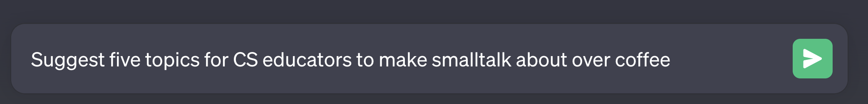
ChatGPT (OpenAI)
Go to chat.openai.com

Slide 38

ChatGPT (OpenAI)
Go to chat.openai.com

Slide 39
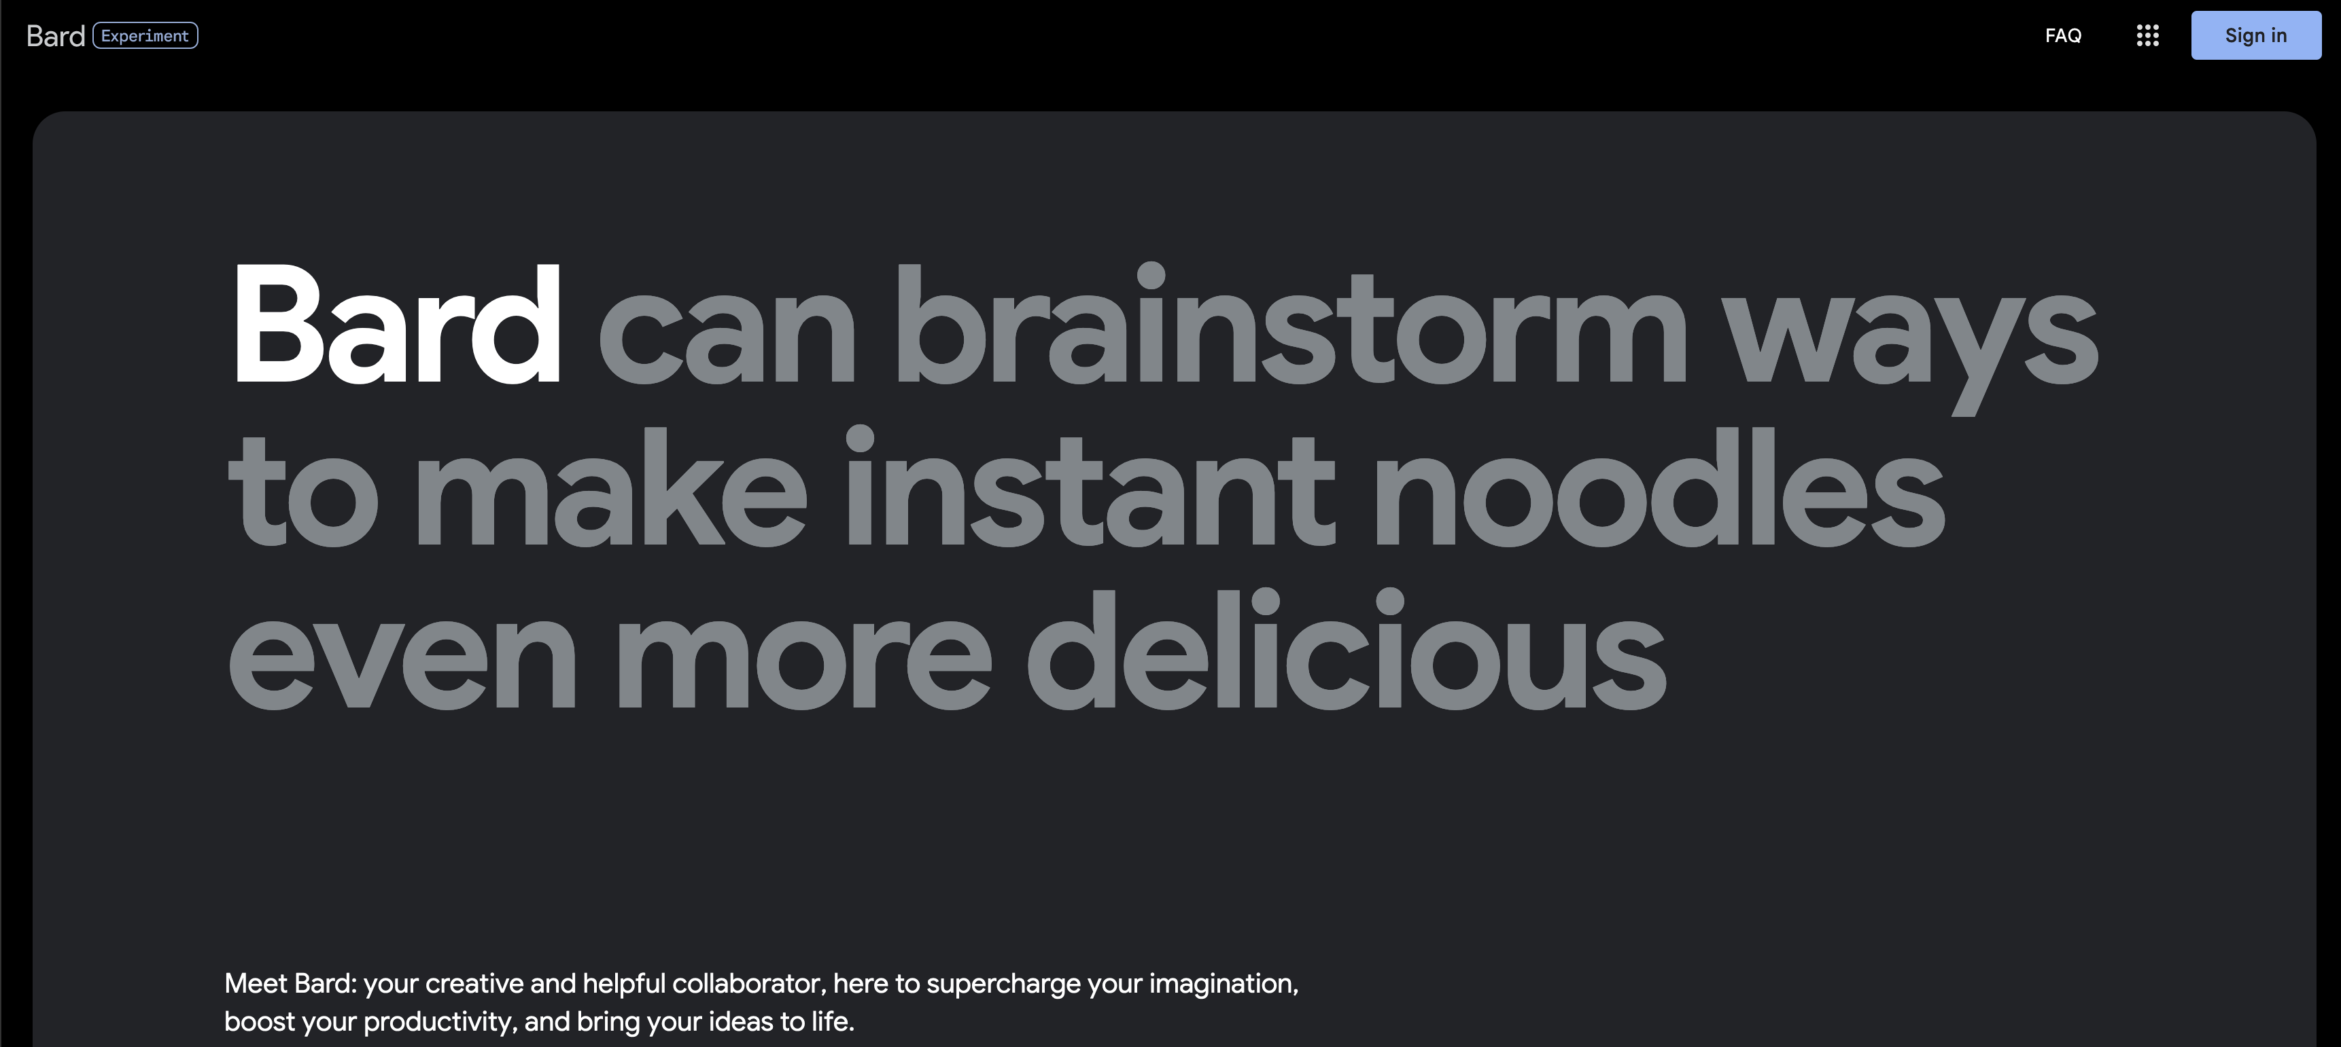
Bard (Google)
Go to: https://bard.google.com/

Slide 40
Bard (Google)
Go to: https://bard.google.com/

Slide 41
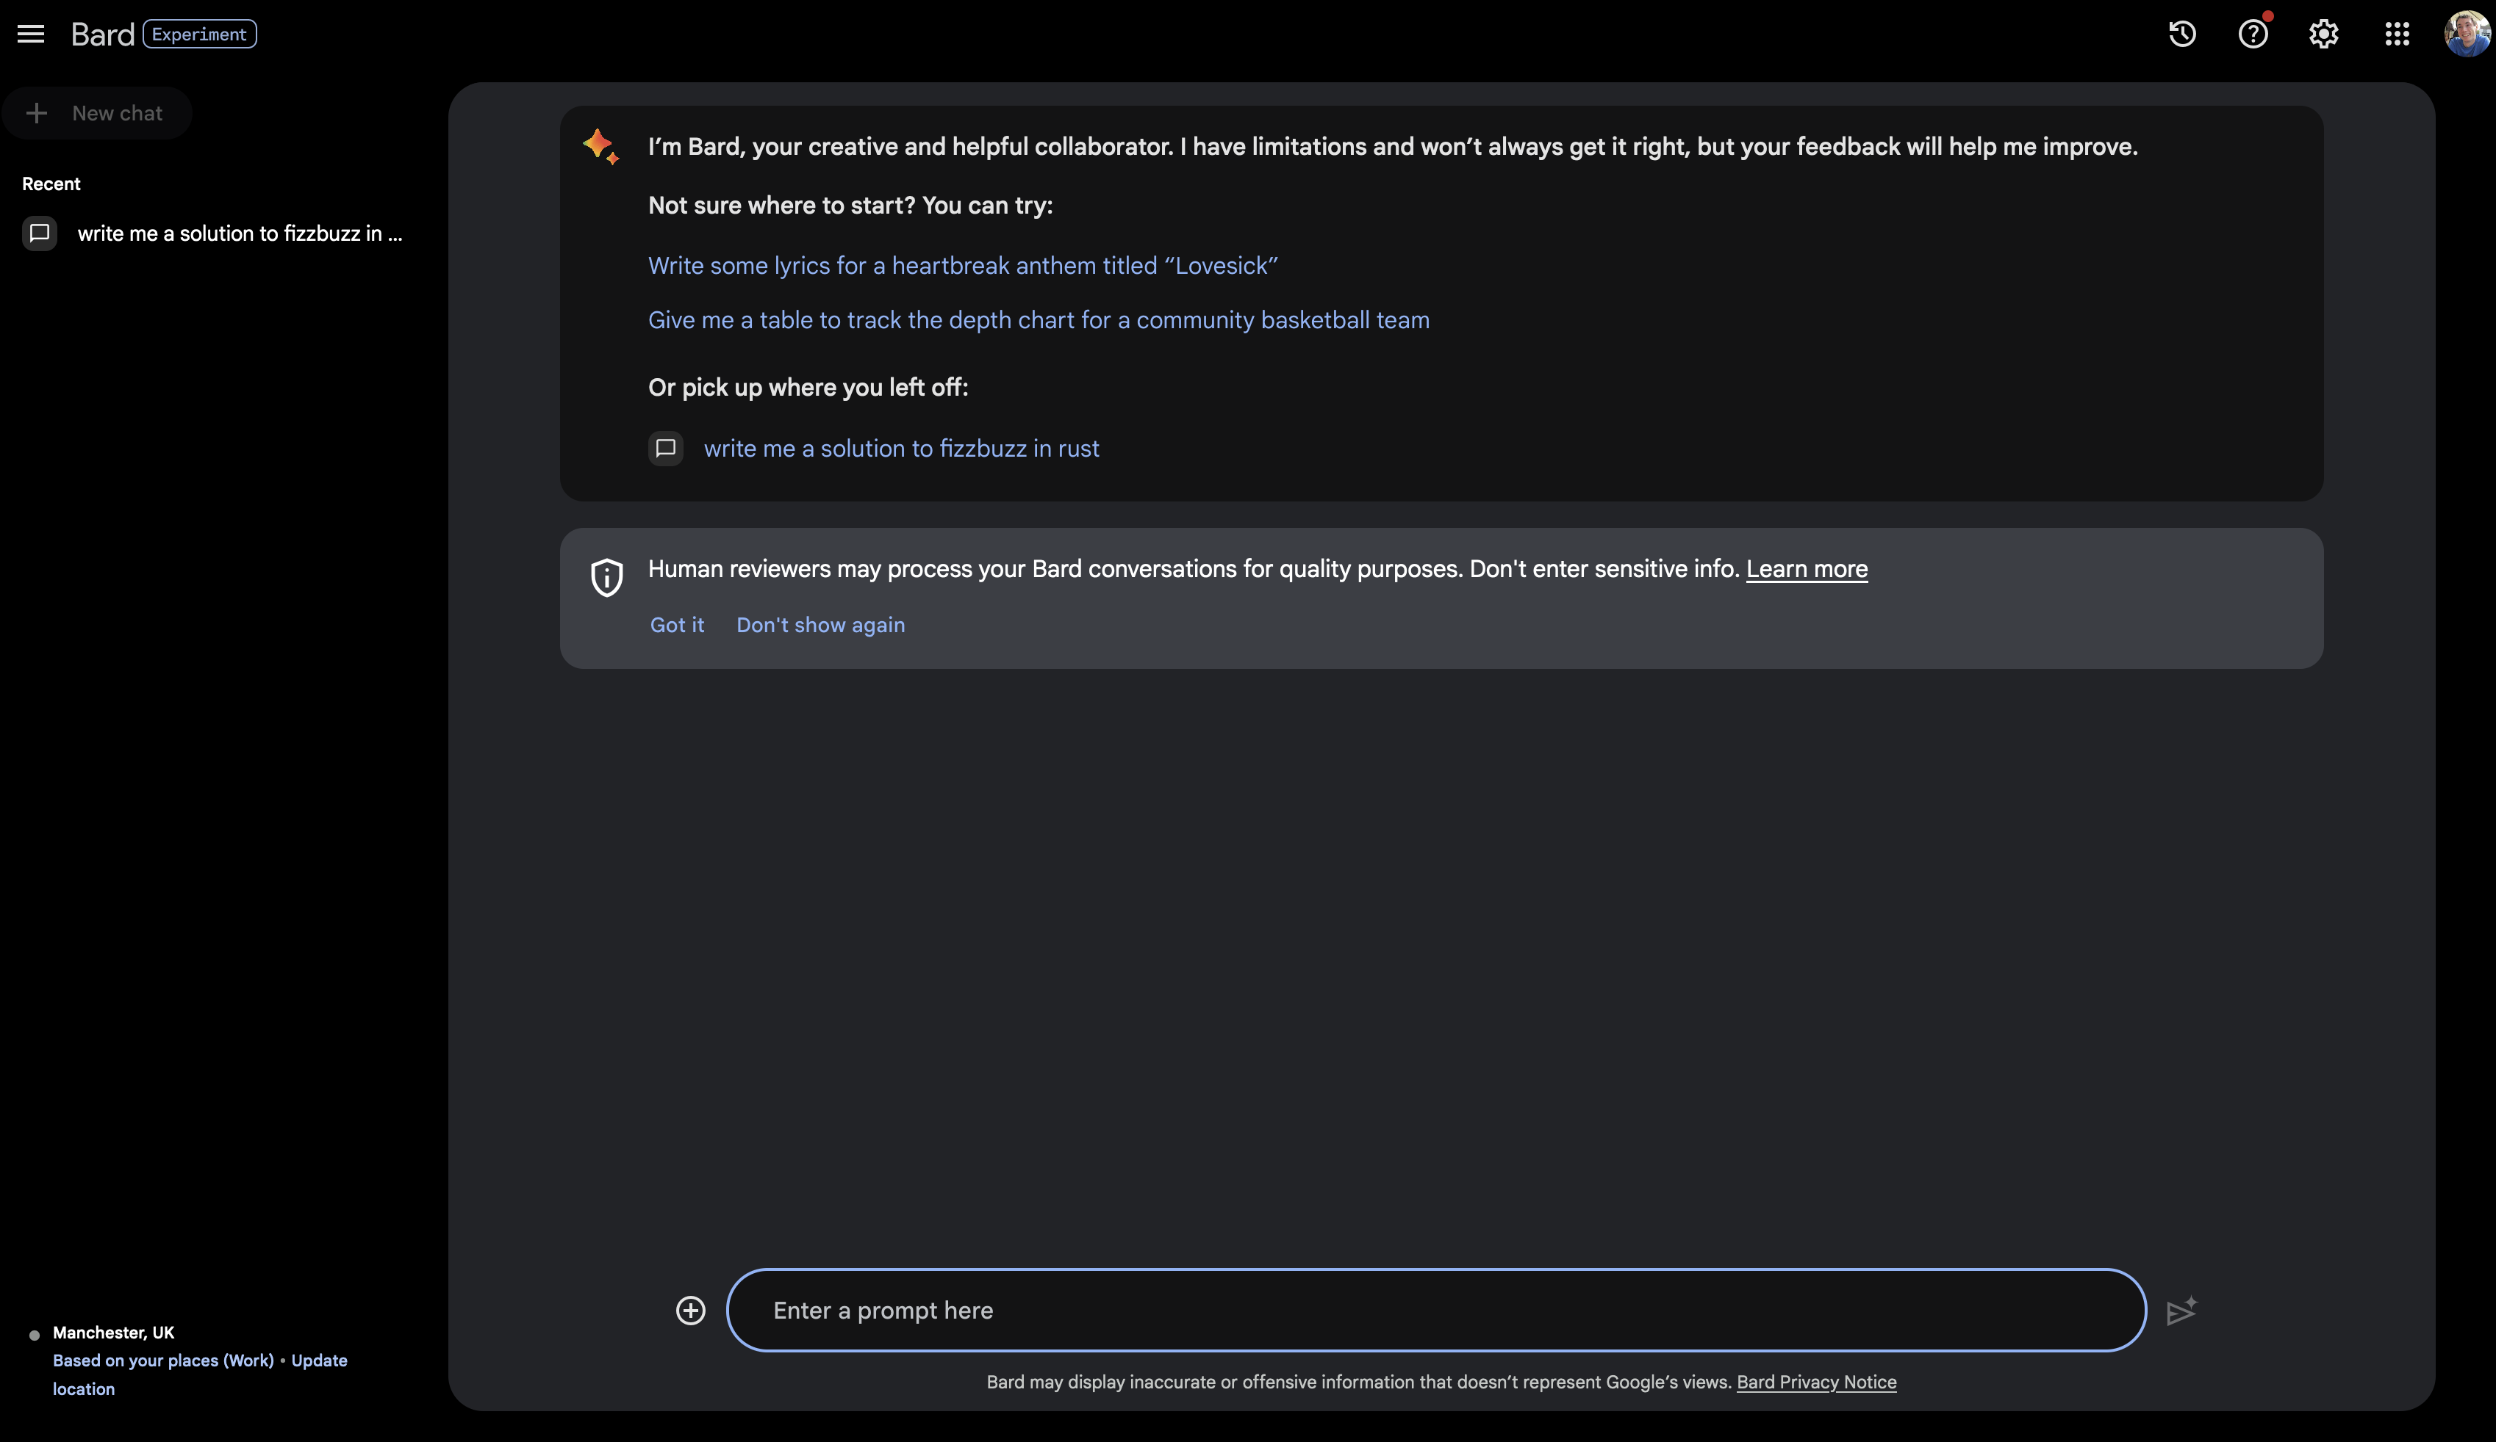

Slide 42
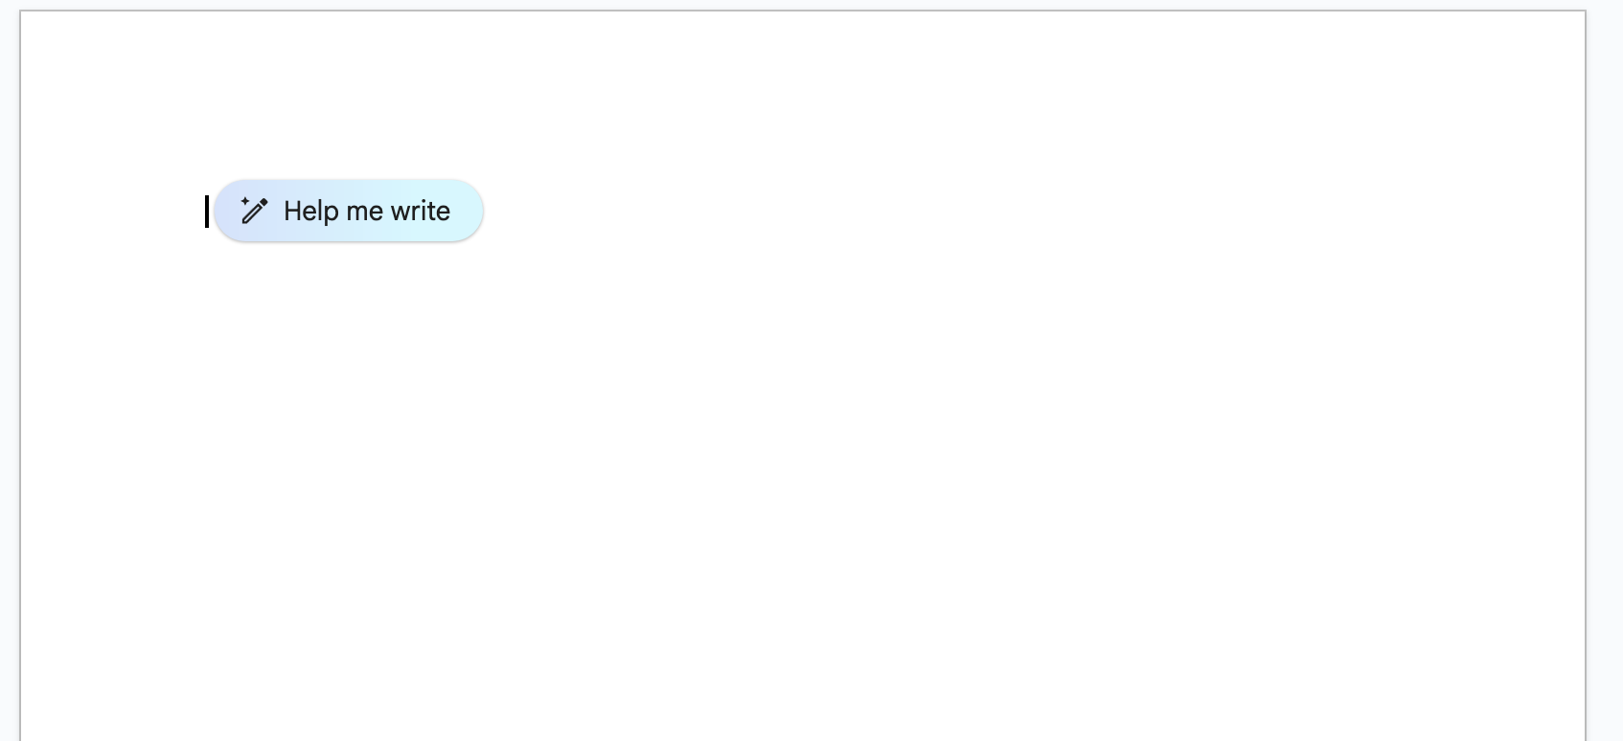
Google Docs (via Google Labs)
Sign up for Google Workspace Labs:
https://workspace.google.com/labs-sign-up/

Slide 43
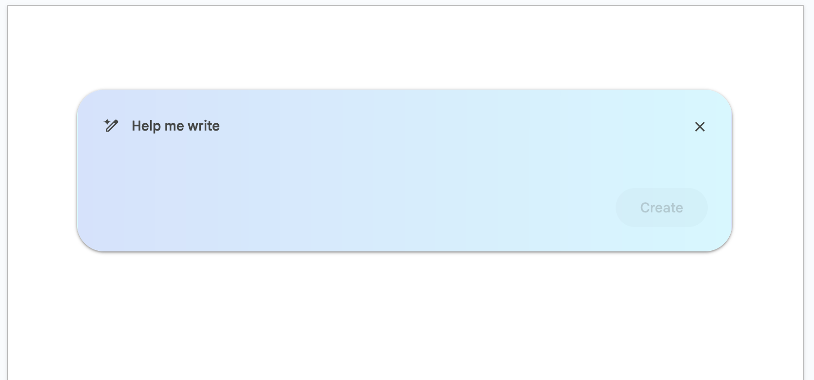
Google Docs (via Google Labs)
Sign up for Google Workspace Labs:
https://workspace.google.com/labs-sign-up/

Slide 44
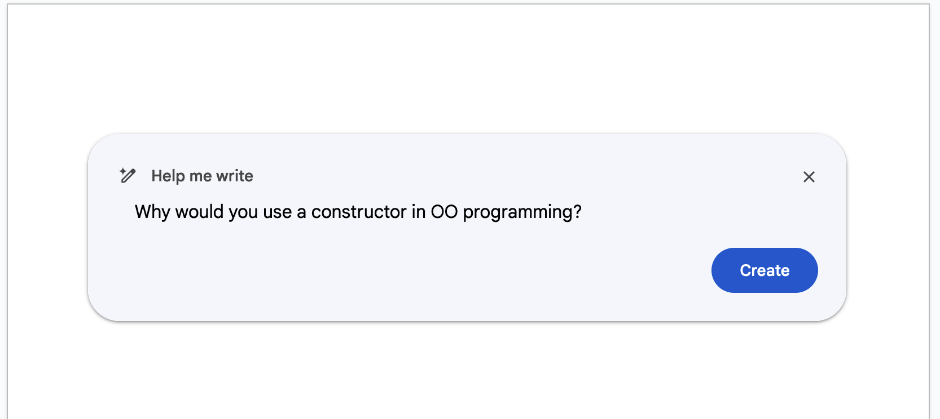
Google Docs (via Google Labs)
Sign up for Google Workspace Labs:
https://workspace.google.com/labs-sign-up/

Slide 45
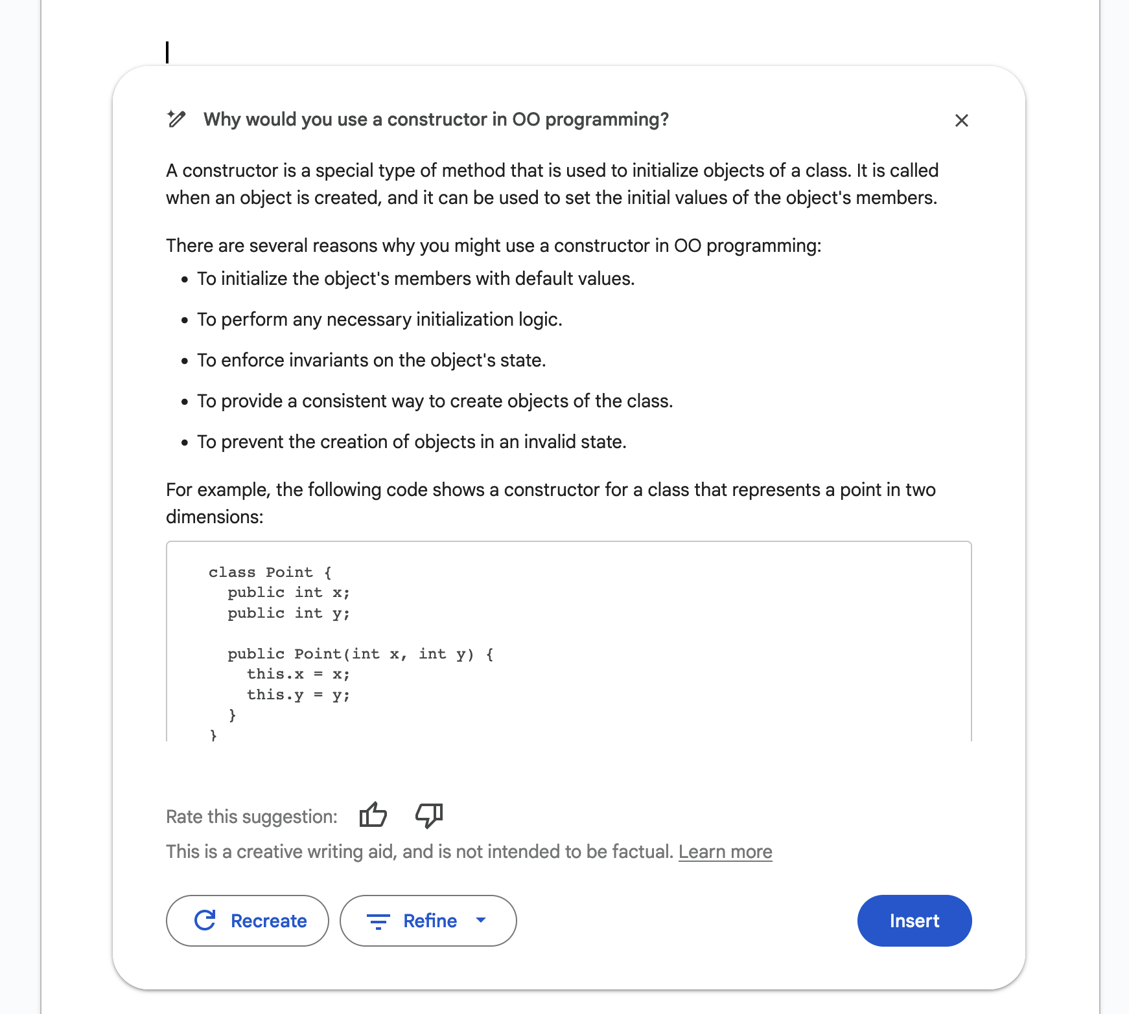
Google Docs (via Google Labs)
Sign up for Google Workspace Labs:
https://workspace.google.com/labs-sign-up/

Slide 46
Google Docs (via Google Labs)
Sign up for Google Workspace Labs:
https://workspace.google.com/labs-sign-up/

Slide 47
Google Docs (via Google Labs)
Sign up for Google Workspace Labs:
https://workspace.google.com/labs-sign-up/

Slide 48
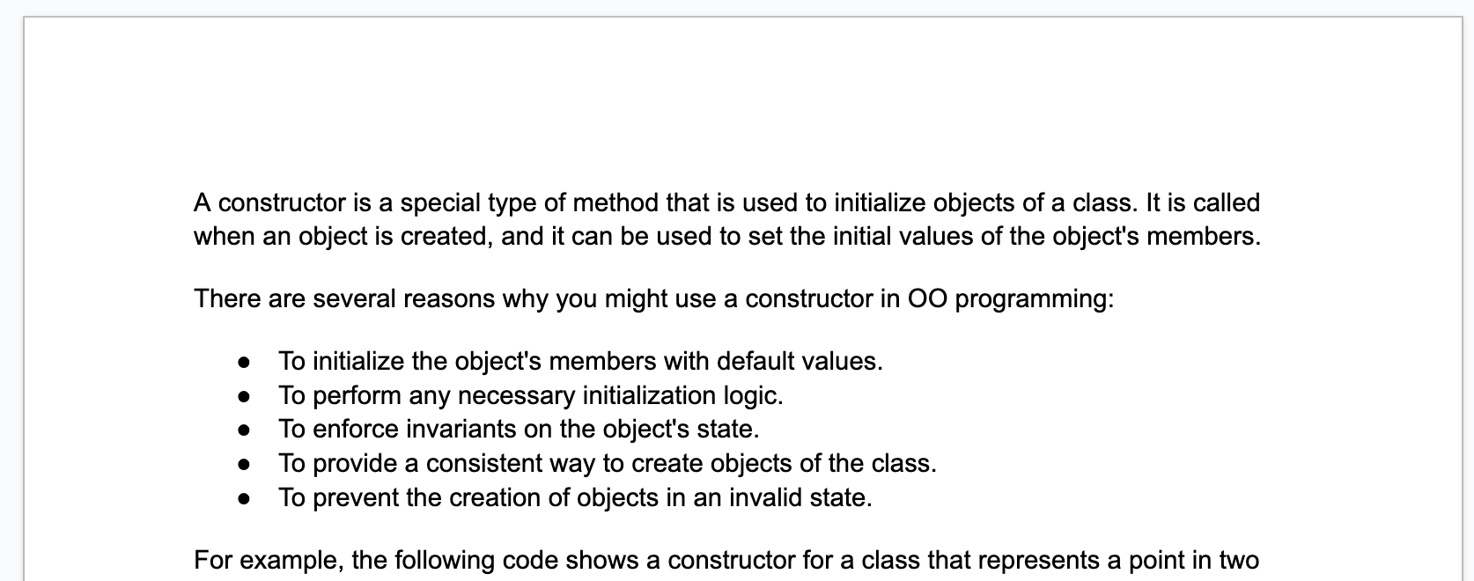
Google Docs (via Google Labs)
Sign up for Google Workspace Labs:
https://workspace.google.com/labs-sign-up/

Slide 49
Session 2: Threat Assessment

